Slide 1
Face Detection and Face Recognition through Haar Cascades, Eigen Face, Fisher Face and Local Binary Pattern Histograms
AINT 513 – Visual Perception and Autonomy
MSc Robotics
Lahiru Dinalankara
Notes:
Welcome to the demonstration of my mini project designed for the AINT – 513 module of Visual perception and autonomy
For the project I have crated a face detection system using Haar cascades.
And face recognition systems using
in hopes of analysing the robustness of each algorithm.

Slide 2
Introduction
Demonstration of the different vision systems designed for face detection and face recognition
Applications for capturing the images for training, training the recognisers and the tilt correction.
Applications for performing automated tests on the algorithms
Brief explanation about the four technologies used in the project
Summary and conclusion
AINT 513 - Visual Perception and Autonomy Lahiru Dinalankara
Notes:
I will first demonstrate the face detection and face recognition systems,
Next the applications to capture face images for the data set, the trainer and the application I wrote to correct the tilt of the head.
Then I will show you the applications I wrote to automate the tests on the algorithms.
Next , the four technologies used in this project.
And finalise it with a conclusion.
I will add time markers below for anyone who wants to go between sections.

Slide 3
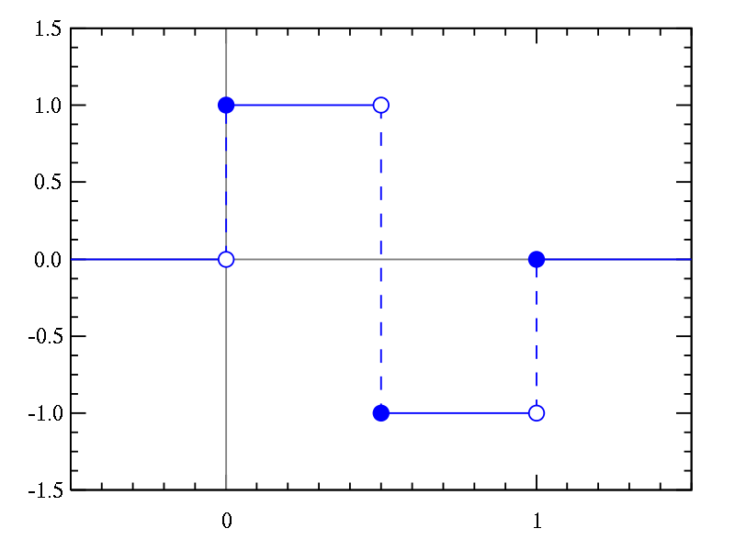
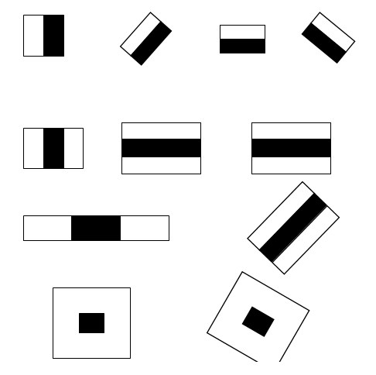
Face Detection - Haar Cascades
A Haar wavelet is a mathematical fiction that produces square shaped waves.
When a signal is viewed from above.
Many more patterns such as these.
AINT 513 - Visual Perception and Autonomy Lahiru Dinalankara
Notes:
A Haar wavelet is a mathematical fiction that creates a square wave.
Unlike other waves, this wave has a beginning and an end.
Because of this it can be used to create box shaped patterns to recognise signals with sudden transformations such as features.
If you give this signal a thickness on the Z axis. Colour the area with 1 black and -1 with white and view it from above, you will see an image such as shown.
You can create more patterns such as these.

Slide 4

Face Detection - Haar Cascades
To analyse an image:
Select a scale
Apply the haar- like feature
Average the portions, is the difference more than the threshold?
Yes = match No = not a match
Increment until the whole image is checked.
A single future is not enough since it would find many matches.
To resolve this issue a cascade of Haar like features used.
AINT 513 - Visual Perception and Autonomy Lahiru Dinalankara
Notes:
How to check for a match
Select a scale
Apply the haar- like feature
Average the portions, is the difference more than the threshold?
Yes = match No = not a match

Slide 5
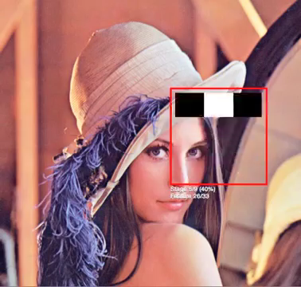
Face Detection - Haar Cascades
Haar Cascade Visualization – By Adam Harvey
AINT 513 - Visual Perception and Autonomy Lahiru Dinalankara

Slide 6
Face Recognition - Eigen-face
The Eigenface provide low-dimensional features of face images
Sirovich and Kirby introduced principal component analysis for collecting features.
M. Turk and A. Pentland expanded these results and presented the Eigenface method of face recognition in 1991.
It is also used in may other areas.
AINT 513 - Visual Perception and Autonomy Lahiru Dinalankara
Notes:
In this section I will explain how PCA and Eigen face work in face recognition.
In 1987 two scientist named Sirovich and Kirby explained that PCA could be used extract features from a set of face images.
These basis images, known as Eigenpictures, could be linearly combined to reconstruct images in the original training set.
In 1991 M. Turk and A. Pentland expanded these results and presented the Eigenface method of face recognition.^{[3]} they showed a way of calculating the eigenvectors of a covariance matrix in such a way as to make it possible for computers at that time to perform eigen-decomposition on a large number of face images.
Face images usually occupy a high-dimensional space and conventional principal component analysis was intractable on such data sets.
Turk and Pentland's paper demonstrated ways to extract the eigenvectors based on matrices sized by the number of images rather than the number of pixels
This technique is also used for
handwriting analysis,
lip reading,
voice recognition,
sign language/hand gestures interpretation
and medical imaging analysis.
Therefore, some do not use the term eigenface, but prefer to use 'eigenimage'.

Slide 7
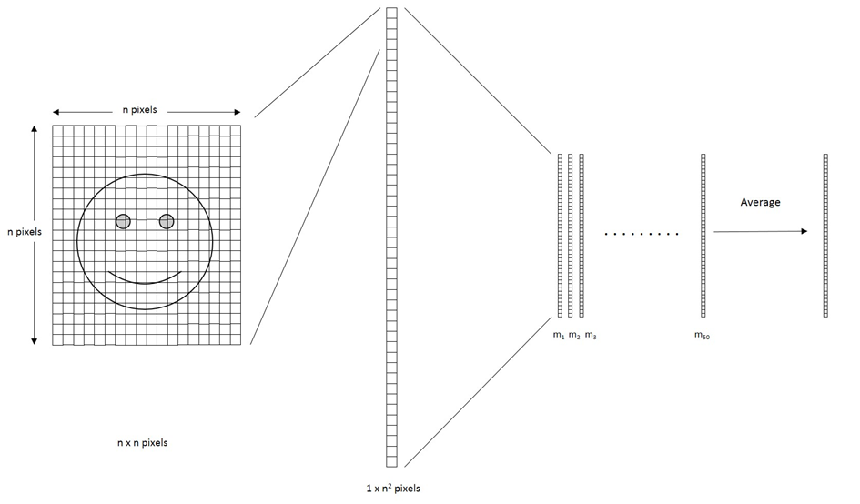
Face Recognition - Eigen-face
a
AINT 513 - Visual Perception and Autonomy Lahiru Dinalankara
Notes:
Prepare a training set of face images.
must be normalized to have the eyes and mouths aligned across all images
hey must also be all resampled to a common pixel resolution
Each image is treated as one vector, simply by concatenating the rows of pixels in the original image, resulting in a single column with n^2 elements.
For this implementation, it is assumed that all images of the training set are stored in a single matrix T,
where each column of the matrix is an image.
Subtract the mean. The average image
a has to be calculated and then subtracted from each original image in T.
each column is a representation of the amount of difference to the average of the dataset faces.
Calculate the eigenvectors and eigenvalues of the covariance matrix S using Principle component analysis.
Each eigenvector has the same dimensionality (number of components) as the original images, and thus can itself be seen as an image.
The eigenvectors of this covariance matrix are therefore called eigenfaces.
They are the directions in which the images differ from the mean image.
Usually this will be a computationally expensive step (if at all possible), but the practical applicability of eigenfaces stems from the possibility to compute the eigenvectors of S efficiently, without ever computing S explicitly
These eigenfaces can now be used to represent both existing and new faces: we can project a new (mean-subtracted) image on the eigenfaces and thereby record how that new face differs from the mean face.

Slide 8
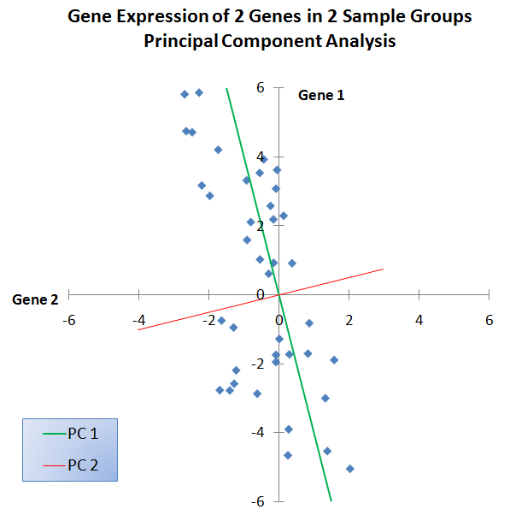
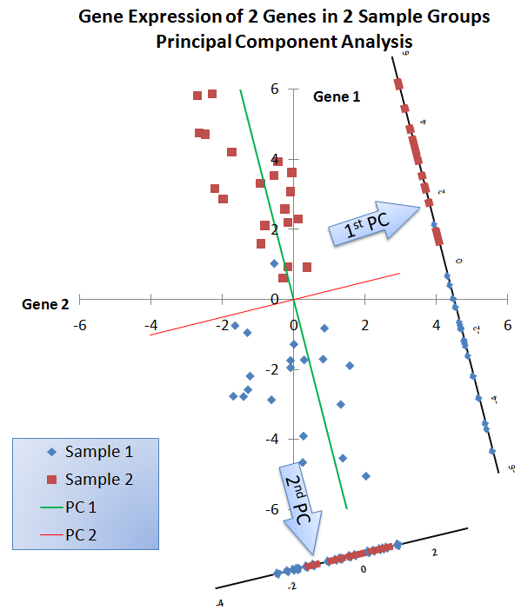
Face Recognition – Fisher face
AINT 513 - Visual Perception and Autonomy Lahiru Dinalankara
Notes:
This image shows classification of data using PCA
Notice that projection of the data onto the first principle component provides good separation between the two sample groups. This is evidently not true for the second principle component.
However, that principle component analysis is not a supervised learning algorithm which means it has no idea what data it is mapping.

Slide 9
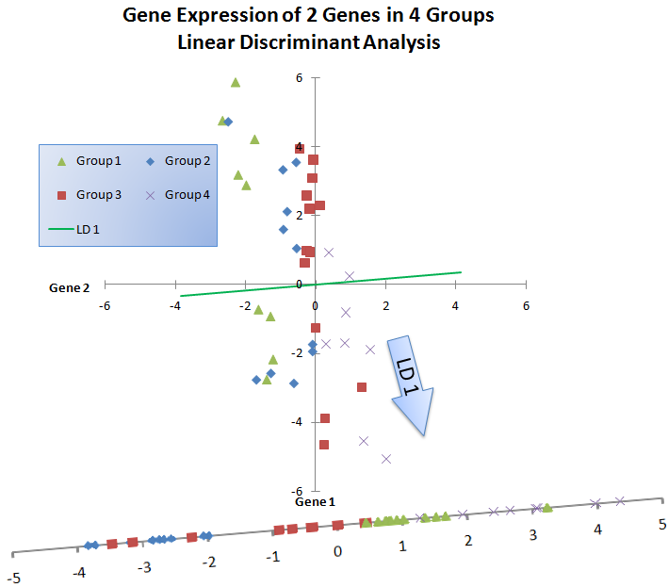
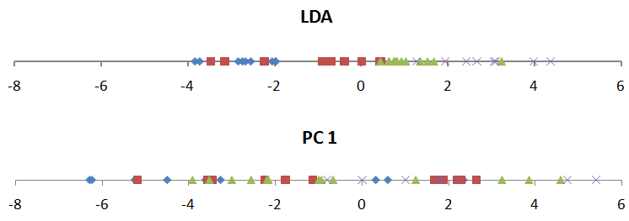
Face Recognition – Fisher face
AINT 513 - Visual Perception and Autonomy Lahiru Dinalankara
Notes:
PCA seeks to capture the maximum total variation between individual sample points,
while LDA seeks to capture the maximum divergence between groups, which requires the minimization of the variation among sample points within the same group.
Often, as in the example data used on this page, the direction of maximum variability between all the points does not correspond to the direction of maximum separability among the groups.
Performing PCA and projecting onto the first principle component (PC1) does not yield the same results as performing LDA and projecting onto the first linear discriminant (LD1).
As seen below, projection onto PC1 yields a homogeneous mix of the data points from the different sample groups.

